Slide 1
Artificial Intelligence: Informed Search
Chapter 4

Slide 2
Outline
Informed = use problem-specific knowledge
Which search strategies?
  Best-first search and its variants
Heuristic functions?
  How to invent them
Discuss sample questions for Exam 1
Local search and optimization
  Hill climbing, local beam search, genetic algorithms,…
Local search in continuous spaces
Online search agents

Slide 3
Informed Tree Search Algorithms
Greedy best-first
A*
IDA* (to be omitted)
Recursive best-first (to be omitted)
SMA* (simplified memory-bounded A*)

Slide 4
Tree-search
function TREE-SEARCH(problem,fringe) return a solution or failure
fringe ← INSERT(MAKE-NODE(INITIAL-STATE[problem]), fringe)
loop do
if EMPTY?(fringe) then return failure
node ← REMOVE-FIRST(fringe)
if GOAL-TEST[problem] applied to STATE[node] succeeds
then return SOLUTION(node)
fringe ← INSERT-ALL(EXPAND(node, problem), fringe)
A strategy is defined by picking the order of node expansion

Slide 5
Best-first search
General approach of informed search:
  Best-first search: node is selected for expansion based on an evaluation function f(n)
Idea: evaluation function measures distance to the goal.
  Choose node which appears best
Q) But doesn’t Uninform Search already do this?
Implementation:
  fringe is queue sorted in decreasing order of desirability.
  Special cases: greedy search, A* search

Slide 6
A heuristic function
[dictionary]“A rule of thumb, simplification, or educated guess that reduces or limits the search for solutions in domains that are difficult and poorly understood.”
  h(n) = estimated cost of the cheapest path from node n to goal node.
  If n is goal then h(n)=0
  More on this later.

Slide 7
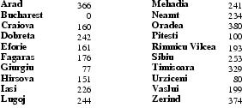
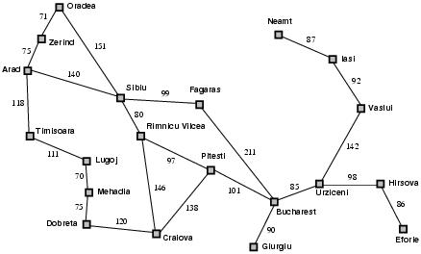
Romania with step costs in km
h_{SLD}=straight-line distance heuristic.
h_{SLD} cannot be directly computed from the problem description itself
In this example f(n)=h(n)
  Expand node that is closest to goal
  = Greedy best-first search

Slide 8
Greedy search example
Arad (366)
Assume that we want to use greedy search to solve the problem of travelling from Arad to Bucharest.
The initial state=Arad

Slide 9
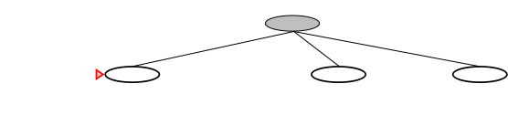
Greedy search example
Arad
Sibiu
(253)
Timisoara
(329)
Zerind
(374)
The first expansion step produces:
  Sibiu, Timisoara and Zerind
Greedy best-first will select Sibiu as it has the smallest h value.

Slide 10
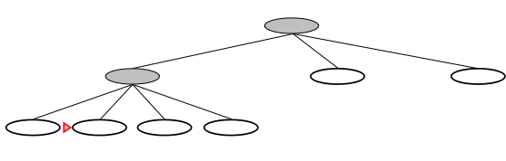
Greedy search example
Arad
Sibiu
Arad
(366)
Fagaras
(176)
Oradea
(380)
Rimnicu Vilcea
(193)
If Sibiu is expanded we get:
  Arad, Fagaras, Oradea and Rimnicu Vilcea
Greedy best-first search will next select: Fagaras

Slide 11
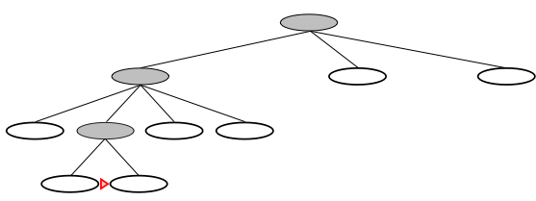
Greedy search example
Arad
Sibiu
Fagaras
Sibiu
(253)
Bucharest
(0)
If Fagaras is expanded we get:
  Sibiu and Bucharest
Goal reached !!
  Yet not optimal (see Arad, Sibiu, Rimnicu Vilcea, Pitesti)
Q1) Why is it that greedy search cannot guarantee an optimal solution?
Q2) What can we do to proceed from here?

Slide 12
Greedy search, evaluation
Completeness: NO (compare with DF-search)
  Check on repeated states
  Minimizing h(n) can result in taking unproductive moves, e.g. Iasi to Fagaras.

Slide 13

Greedy search, evaluation
Completeness: NO (cf. DF-search)
Time complexity?
  Same as Worst-case DF-search
  (with m is maximum depth of search space)
  Good heuristic can give dramatic improvement in run time – actual run time may grow at a rate <<

Slide 14
Greedy search, evaluation
Completeness: NO (cf. DF-search)
Time complexity:
Space complexity:
  Keeps all nodes in memory unlike DF-search

Slide 15
Greedy search, evaluation
Completeness: NO (cf. DF-search)
Time complexity:
Space complexity:
Optimality? NO
  Same as DF-search

Slide 16
A* search
Best-known form of best-first search.
Idea: avoid expanding paths that are assumed expensive.
Evaluation function f(n)=g(n) + h(n)
  g(n) the cost (so far) to reach the node.
  h(n) estimated cost to get from the node to the goal.
  f(n) estimated total cost of path through n to goal.

Slide 17
A* search
A* search uses an admissible heuristic
  A heuristic is admissible if it never overestimates the cost to reach the goal
  Is optimistic
    Formally:
    1. h(n) <= h*(n) where h*(n) is the true cost from n
    2. h(n) >= 0 and h(G)=0 for any goal G.
    e.g. h_{SLD}(n) never overestimates the actual road distance

Slide 18
Romania example

Slide 19
A* search example
Find Bucharest starting at Arad
  f(Arad) = c(Arad,Arad)+h(Arad)=0+366=366

Slide 20

A* search example
Expand Arrad and determine f(n) for each node
  f(Sibiu)=c(Arad,Sibiu)+h(Sibiu)=140+253=393
  f(Timisoara)=c(Arad,Timisoara)+h(Timisoara)=118+329=447
  f(Zerind)=c(Arad,Zerind)+h(Zerind)=75+374=449
Best choice is Sibiu

Slide 21
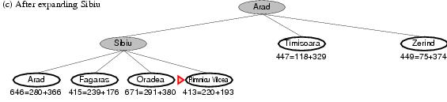
A* search example
Expand Sibiu and determine f(n) for each node
  f(Arad)=c(Sibiu,Arad)+h(Arad)=280+366=646
  f(Fagaras)=c(Sibiu,Fagaras)+h(Fagaras)=239+179=415
  f(Oradea)=c(Sibiu,Oradea)+h(Oradea)=291+380=671
  f(Rimnicu Vilcea)=c(Sibiu,Rimnicu Vilcea)+
  h(Rimnicu Vilcea)=220+192=413
Best choice is Rimnicu Vilcea

Slide 22
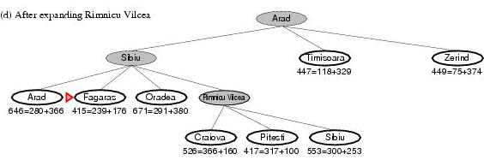
A* search example
Expand Rimnicu Vilcea and determine f(n) for each node
  f(Craiova)=c(Rimnicu Vilcea, Craiova)+h(Craiova)= 360+160=526
  f(Pitesti)=c(Rimnicu Vilcea, Pitesti)+h(Pitesti)=317+100=417
  f(Sibiu)=c(Rimnicu Vilcea,Sibiu)+h(Sibiu)=300+253=553
Best choice is Fagaras

Slide 23
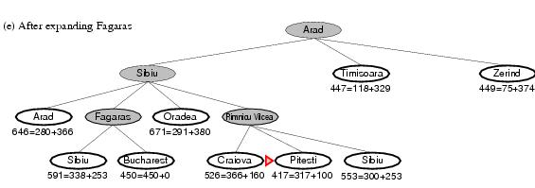
A* search example
Expand Fagaras and determine f(n) for each node
  f(Sibiu)=c(Fagaras, Sibiu)+h(Sibiu)=338+253=591
  f(Bucharest)=c(Fagaras,Bucharest)+h(Bucharest)= 450+0=450
Best choice is Pitesti !

Slide 24
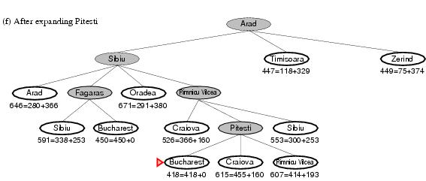
A* search example
Expand Pitesti and determine f(n) for each node
  f(Bucharest)=c(Pitesti,Bucharest)+h(Bucharest)=418+0=418
Best choice is Bucharest !
  Optimal solution (only if h(n) is admissible)
Constrast with path taken by greedy method – we see that h on its own can be misleading

Slide 25
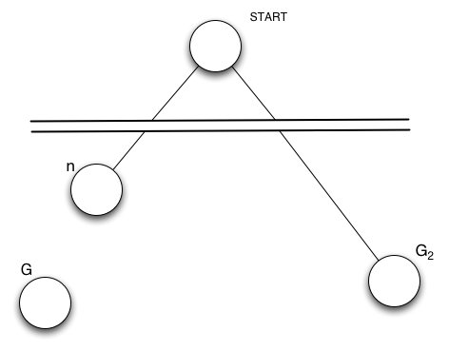
Optimality of A*(standard proof)
Suppose suboptimal goal G₂ in the queue.
Let n be an unexpanded node on a shortest path to optimal goal G.
    f(G₂ ) = g(G₂ ) since h(G₂ )=0
    > g(G) since G₂ is suboptimal
    >= f(n) since h is admissible
    Since f(G₂) > f(n), A* will never select G₂ for expansion

Slide 26
BUT … graph search
Discards new paths to repeated state.
  Previous proof breaks down for graphs (still works for trees)
Solution:
  Add extra bookkeeping i.e. remove more expensive of two paths.
  Ensure that optimal path to any repeated state is always first followed.
    Extra requirement on h(n): consistency (monotonicity)

Slide 27
A* Graph Search Gone Wrong?
State space graph
Search tree
h=4
A
h=1
S (0+2)
S
1
1
C
A (1+4)
B (1+1)
h=2
1
2
B
3
C (2+1)
C (3+1)
h=1
G
G (5+0)
G (6+0)
h=0
Simple check against expanded set blocks C
Better check allows new C if cheaper than old but requires recalculating C’s descendants

Slide 28
Consistency of Heuristics
Main idea: estimated heuristic costs ≤ actual costs
  Admissibility: heuristic cost ≤ actual cost to goal
  h(A) ≤ h*(A)
  Consistency: heuristic “arc” cost ≤ actual cost for each arc
  h(A) – h(C) ≤ c(A,C)
  or h(A) ≤ c(A,C) + h(C) (triangle inequality)
Consequences of consistency:
  The f value along a path never decreases:
  h(A) ≤ c(A,C) + h(C) => g(A) + h(A) ≤ g(A) + c(A,C) + h(C)
  A* graph search is optimal
A
1
C
h=4
h=1
h=3
3
G

Slide 29
A* search, evaluation
Completeness: YES
Time complexity:
  Number of nodes expanded is still exponential in the length of the solution.

Slide 30
A* search, evaluation
Completeness: YES
Time complexity: (exponential with path length)
Space complexity:
  It keeps all generated nodes in memory
  Hence space is the major problem, not time

Slide 31
A* search, evaluation
Completeness: YES
Time complexity: (exponential with path length)
Space complexity:(all nodes are stored)
Optimality: YES
  Cannot expand f_{i+1} until f_{i} is finished.
  A* expands all nodes with f(n)< C*
  A* expands some nodes with f(n)=C*
  A* expands no nodes with f(n)>C*
Also optimally efficient (not including ties)

Slide 32
Informed Tree Search Algorithms
Greedy best-first
A*
IDA*
Recursive best-first
SMA* (simplified memory-bounded A*)

Slide 33
Memory-bounded heuristic search
Some solutions to A* space problems (maintain completeness and optimality)
  Iterative-deepening A* (IDA*)
    Here cutoff information is the f-cost (g+h) instead of depth
  Recursive best-first search(RBFS)
    Recursive algorithm that attempts to mimic standard best-first search with linear space.
  (simple) Memory-bounded A* ((S)MA*)
    Drop the worst-leaf node when memory is full

Slide 34
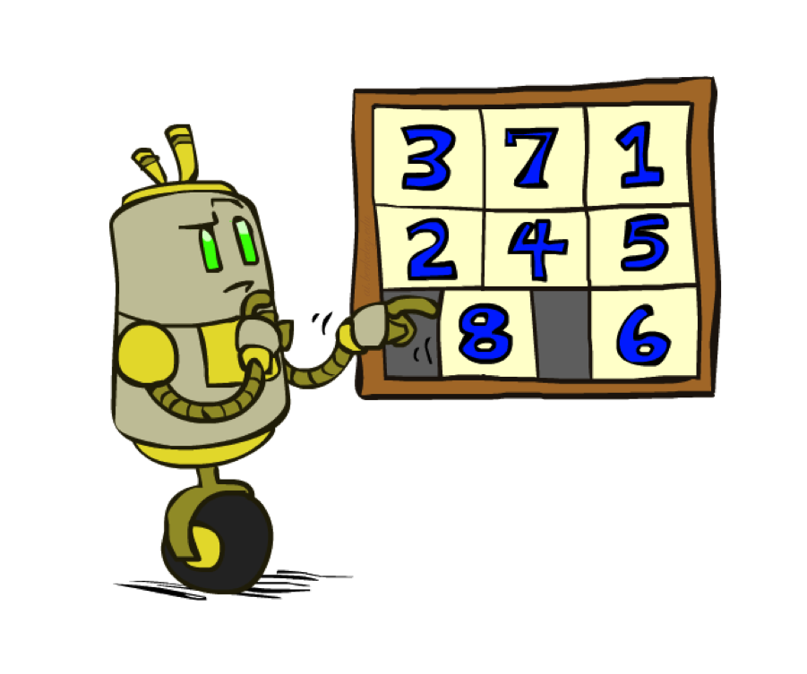
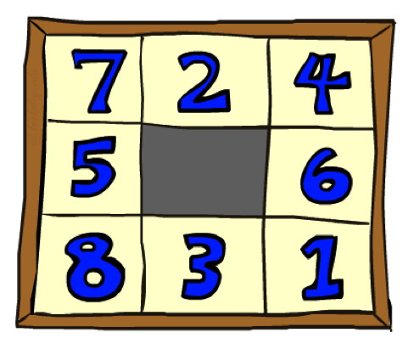
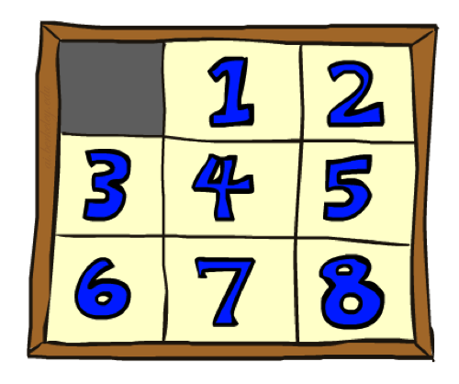
Example: 8 Puzzle
Start State
Actions
Goal State
What are the states?
How many states?
What are the actions?
What are the step costs?
Notes:
9! = 362,880 but 16! (15-puzzle) = 20 trillion, 25! = 10^25

Slide 35
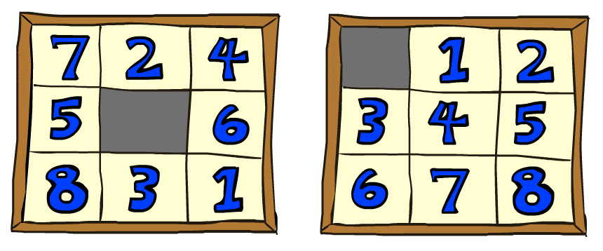
8 Puzzle I
Heuristic: Number of tiles misplaced
Why is it admissible?
h(start) =
8
Start State
Goal State
 | Average nodes expanded when the optimal path has…
 | …4 steps | …8 steps | …12 steps
UCS | 112 | 6,300 | 3.6 x 10⁶
A*TILES | 13 | 39 | 227
Statistics from Andrew Moore

Slide 36
8 Puzzle II
What if we had an easier 8-puzzle where any tile could slide any direction at any time, ignoring other tiles?
Total Manhattan distance
Why is it admissible?
h(start) =
Start State
Goal State
 | Average nodes expanded when the optimal path has…
 | …4 steps | …8 steps | …12 steps
A*TILES | 13 | 39 | 227
A*MANHATTAN | 12 | 25 | 73
3 + 1 + 2 + … = 18

Slide 37
Heuristic quality
Effective branching factor b*
  Is the branching factor that a uniform tree of depth d would have in order to contain N+1 nodes.
  Measure is fairly constant for sufficiently hard problems.
    Can thus provide a good guide to the heuristic’s overall usefulness.
    A good value of b* is a value close to 1.

Slide 38
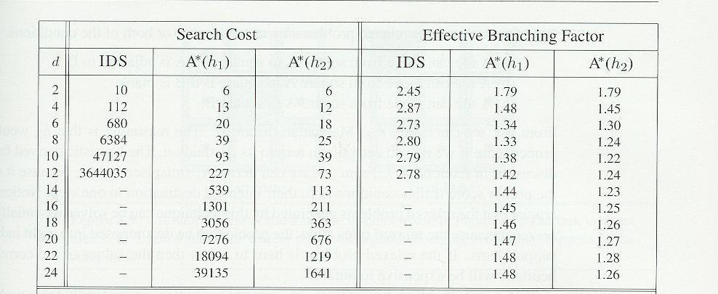
Heuristic quality and dominance
1200 random problems with solution lengths from 2 to 24.
If h₂(n) >= h₁(n) for all n (both admissible)
then h₂ dominates h₁ and is better for search

Slide 39
Practice Questions for Exam 1
Q1) There are six characteristics of an environment. Enumerate each of the six and for each give the alternatives. (For example: One is single agent and it has a single alternative, multi-agent.) You need not describe the characteristic.
Q2) The text describes five types of agents (e.g., simple reflex agent). Excluding learning agent, describe any two.
Q3)For the depth first search. Explain
  Why it does not have the completeness property.
  Why is space complexity is O(bm) where m is the maximum depth of the solution
  Why its time complexity is O(b^{m})?

Slide 40

Combining heuristics
Dominance: h₁ ≥ h₂ if
∀n h₁(n) ≥ h₂(n)
  Roughly speaking, larger is better as long as both are admissible
  The zero heuristic is pretty bad (what does A* do with h=0?)
  The exact heuristic is pretty good, but usually too expensive!
What if we have two heuristics, neither dominates the other?
  Form a new heuristic by taking the max of both:
  h(n) = max( h₁(n), h₂(n))
  Max of admissible heuristics is admissible and dominates both!
  Example: number of knight’s moves to get from A to B
    h1 = (Manhattan distance)/3 (rounded up to correct parity)
    h2 = (Euclidean distance)/√5 (rounded up to correct parity)
    h3 = (max x or y shift)/2 (rounded up to correct parity)
Notes:
Semi-lattice: x <= y <-> x = x ^ y

Slide 41
Recursive best-first search
function RECURSIVE-BEST-FIRST-SEARCH(problem) return a solution or failure
return RFBS(problem,MAKE-NODE(INITIAL-STATE[problem]),∞)
function RFBS( problem, node, f_limit) return a solution or failure and a new f-cost limit
if GOAL-TEST[problem](STATE[node]) then return node
successors ← EXPAND(node, problem)
if successors is empty then return failure, ∞
for each s in successors do
f [s] ← max(g(s) + h(s), f [node])
repeat
best ← the lowest f-value node in successors
if f [best] > f_limit then return failure, f [best]
alternative ← the second lowest f-value among successors
result, f [best] ← RBFS(problem, best, min(f_limit, alternative))
if result ≠ failure then return result

Slide 42
Recursive best-first search
Keeps track of the f-value of the best-alternative path available.
  If current f-values exceeds this alternative f-value than backtrack to alternative path.
  Upon backtracking change f-value to best f-value of its children.
  Re-expansion of this result is thus still possible.

Slide 43
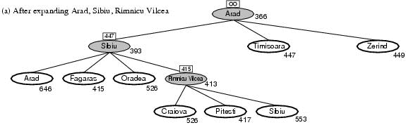
Recursive best-first search, ex.
Path until Rumnicu Vilcea is already expanded
Above node; f-limit for every recursive call is shown on top.
Below node: f(n)
The path is followed until Pitesti which has a f-value worse than the f-limit.

Slide 44
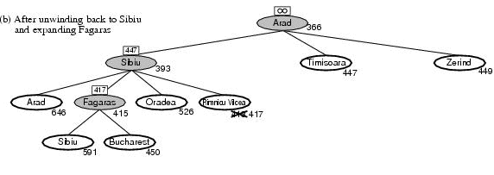
Recursive best-first search, ex.
Unwind recursion and store best f-value for current best leaf Pitesti
result, f [best] ← RBFS(problem, best, min(f_limit, alternative))
best is now Fagaras. Call RBFS for new best
  best value is now 450

Slide 45
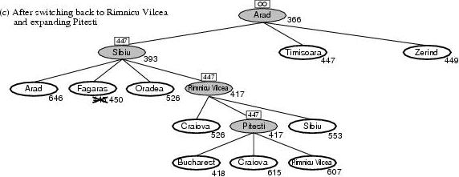
Recursive best-first search, ex.
Unwind recursion and store best f-value for current best leaf Fagaras
result, f [best] ← RBFS(problem, best, min(f_limit, alternative))
best is now Rimnicu Viclea (again). Call RBFS for new best
  Subtree is again expanded.
  Best alternative subtree is now through Timisoara.
Solution is found since because 447 > 417.

Slide 46
RBFS evaluation
RBFS is a bit more efficient than IDA*
  Still excessive node generation (mind changes)
Like A*, optimal if h(n) is admissible
Space complexity is O(bd).
  IDA* retains only one single number (the current f-cost limit)
Time complexity difficult to characterize
  Depends on accuracy if h(n) and how often best path changes.
IDA* and RBFS suffer from too little memory.

Slide 47
(simplified) memory-bounded A*
Use all available memory.
  I.e. expand best leafs until available memory is full
  When full, SMA* drops worst leaf node (highest f-value)
  Like RFBS backup forgotten node to its parent
What if all leafs have the same f-value?
  Same node could be selected for expansion and deletion.
  SMA* solves this by expanding newest best leaf and deleting oldest worst leaf.
SMA* is complete if solution is reachable, optimal if optimal solution is reachable.

Slide 48
Inventing admissible heuristics
Admissible heuristics can be derived from the exact solution cost of a relaxed version of the problem:
  Relaxed 8-puzzle for h₁ : a tile can move anywhere
    As a result, h₁(n) gives the shortest solution
  Relaxed 8-puzzle for h₂ : a tile can move to any adjacent square.
    As a result, h₂(n) gives the shortest solution.
The optimal solution cost of a relaxed problem is no greater than the optimal solution cost of the real problem.
ABSolver found a useful heuristic for the rubric cube.

Slide 49
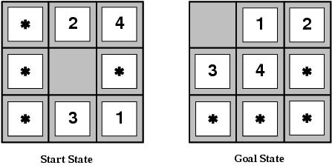
Inventing admissible heuristics
Admissible heuristics can also be derived from the solution cost of a subproblem of a given problem.
This cost is a lower bound on the cost of the real problem.
Pattern databases store the exact solution to for every possible subproblem instance.
  The complete heuristic is constructed using the patterns in the DB

Slide 50
Inventing admissible heuristics
Another way to find an admissible heuristic is through learning from experience:
  Experience = solving lots of 8-puzzles
  An inductive learning algorithm can be used to predict costs for other states that arise during search.

Slide 51
Subunit overview
Local search
  Hill climbing
  Simulated annealing
  Local beam search
  Stochastic local beam search
  Genetic algorithms

Slide 52
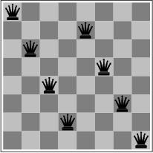
Local search and optimization
Previously: systematic exploration of search space.
  Path to goal is solution to problem
YET, for some problems path is irrelevant.
  E.g 8-queens
Different algorithms can be used
  Local search

Slide 53
Local search and optimization
Local search= use single current state and move to neighboring states.
Advantages:
  Use very little memory
  Find often reasonable solutions in large or infinite state spaces.
Are also useful for pure optimization problems.
  Find best state according to some objective function.
  e.g. survival of the fittest as a metaphor for optimization.

Slide 54

Local search and optimization

Slide 55
Hill-climbing search
“is a loop that continuously moves in the direction of increasing value”
  It terminates when a peak is reached.
Hill climbing does not look ahead of the immediate neighbors of the current state.
Hill-climbing chooses randomly among the set of best successors, if there is more than one.
Hill-climbing a.k.a. greedy local search

Slide 56
Hill-climbing search
function HILL-CLIMBING( problem) return a state that is a local maximum
input: problem, a problem
local variables: current, a node.
neighbor, a node.
current ← MAKE-NODE(INITIAL-STATE[problem])
loop do
neighbor ← a highest valued successor of current
if VALUE [neighbor] ≤ VALUE[current] then return
STATE[current]
current ← neighbor

Slide 57
Hill-climbing example
8-queens problem (complete-state formulation).
Successor function: move a single queen to another square in the same column.
Heuristic function h(n): the number of pairs of queens that are attacking each other (directly or indirectly).

Slide 58
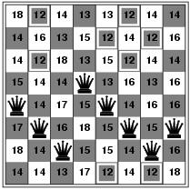

Hill-climbing example
a)
b)
a) shows a state of h=17 and the h-value for each possible successor.
b) A local minimum in the 8-queens state space (h=1).

Slide 59
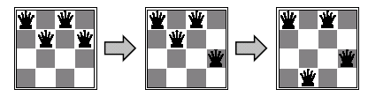
Min-conflicts example 1
h=5
h=3
h=1
Use of min-conflicts heuristic in hill-climbing.

Slide 60
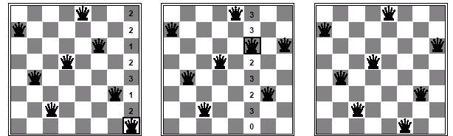
Min-conflicts example 2
A two-step solution for an 8-queens problem using min-conflicts heuristic.
At each stage a queen is chosen for reassignment in its column.
The algorithm moves the queen to the min-conflict square breaking ties randomly.

Slide 61
Advantages of local search
The runtime of min-conflicts is roughly independent of problem size.
  Solving the millions-queen problem in roughly 50 steps.
Local search can be used in an online setting.
  Backtrack search requires more time

Slide 62
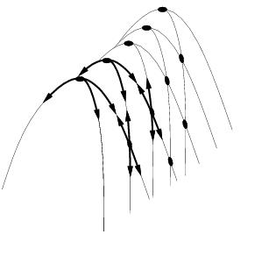
Drawbacks
Ridge = sequence of local maxima difficult for greedy algorithms to navigate
Plateau = an area of the state space where the evaluation function is flat.
Gets stuck 86% of the time.

Slide 63
Hill-climbing variations
Stochastic hill-climbing
  Random selection among the uphill moves.
  The selection probability can vary with the steepness of the uphill move.
First-choice hill-climbing
  cf. stochastic hill climbing by generating successors randomly until a better one is found.
Random-restart hill-climbing
  Tries to avoid getting stuck in local maxima.

Slide 64
Simulated annealing
Escape local maxima by allowing “bad” moves.
  Idea: but gradually decrease their size and frequency.
Origin; metallurgical annealing
Bouncing ball analogy:
  Shaking hard (= high temperature).
  Shaking less (= lower the temperature).
If T decreases slowly enough, best state is reached.
Applied for VLSI layout, airline scheduling, etc.

Slide 65
Simulated annealing
function SIMULATED-ANNEALING( problem, schedule) return a solution state
input: problem, a problem
schedule, a mapping from time to temperature
local variables: current, a node.
next, a node.
T, a “temperature” controlling the probability of downward steps
current ← MAKE-NODE(INITIAL-STATE[problem])
for t ← 1 to ∞ do
T ← schedule[t]
if T = 0 then return current
next ← a randomly selected successor of current
∆E ← VALUE[next] - VALUE[current]
if ∆E > 0 then current ← next
else current ← next only with probability e^{∆E /T}

Slide 66
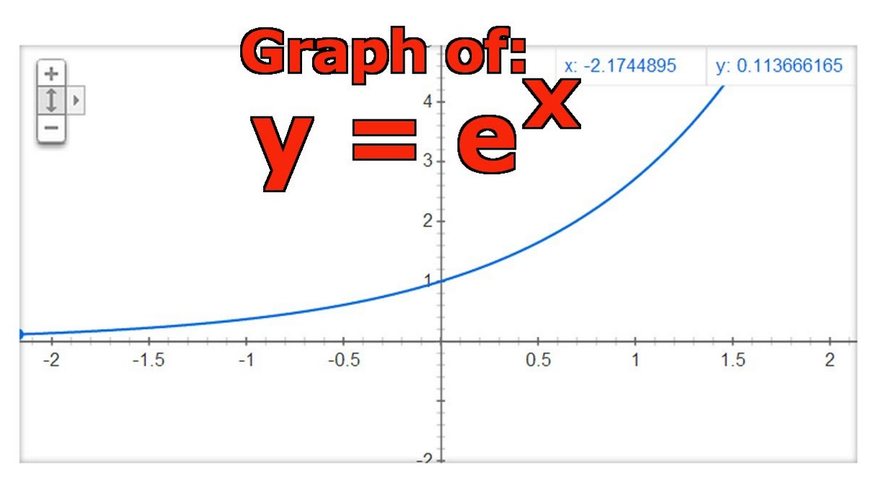
x = e^{ΔE/T}

Slide 67
Local beam search
Keep track of k states instead of one
  Initially: k random states
  Next: determine all successors of k states
  If any of successors is goal → finished
  Else select k best from successors and repeat.
Major difference with random-restart search
  Information is shared among k search threads.
Can suffer from lack of diversity.
  Stochastic variant: choose k successors at proportionally to state success.

Slide 68
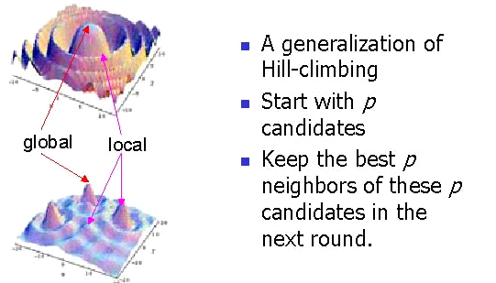
Local Beam Search
k
k
k

Slide 69
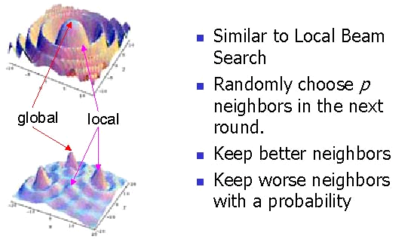
Stochastic Local Beam Search
k

Slide 70
AI in the News
January 9, 2007: CES Notebook - Roomba Rival. By Ryan Nakashima. The Associated Press / available from The Globe and Mail. "Roomba, watch out. A vacuuming robot from South Korea is looking to clean up after you. Microrobot Co. Ltd. is showing off [at CES in Las Vegas] a round, cake-shaped cleaning bot, the Ubot.... 'It knows where it has cleaned so it doesn't go over the cleaned area,' said Microrobot employee Sang-Won Kim. ... The robot has been selling in South Korea since late 2005."
March 29, 2007: Dyson preparing a Roomba killer? New Scientist Technology Blog posting by Tom Simonite, New Scientist online technology reporter. "A job advert posted on the website of vacuum cleaner manufacturer Dyson hints at what its next headline-grabbing product may be. It seems they are trying to recruit roboticists - could they be aiming to sweep aside iRobot's Roomba and Electrolux's Trilobite robotic cleaners?"

Slide 71
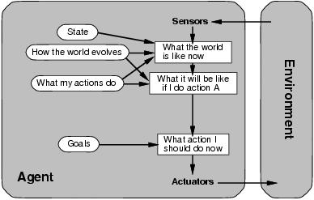
Agent types: goal-based
The agent needs a goal to know which situations are desirable.
  Things become difficult when long sequences of actions are required to find the goal.
Typically investigated in search and planning research.
Major difference: future is taken into account
Is more flexible since knowledge is represented explicitly and can be manipulated.

Slide 72
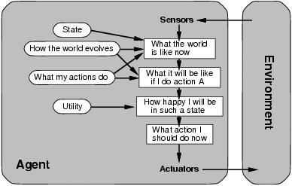
Agent types: utility-based
Certain goals can be reached in different ways.
  Some are better, have a higher utility.
Utility function maps a (sequence of) state(s) onto a real number.
Improves on goals:
  Selecting between conflicting goals
  Select appropriately between several goals based on likelihood of success.

Slide 73
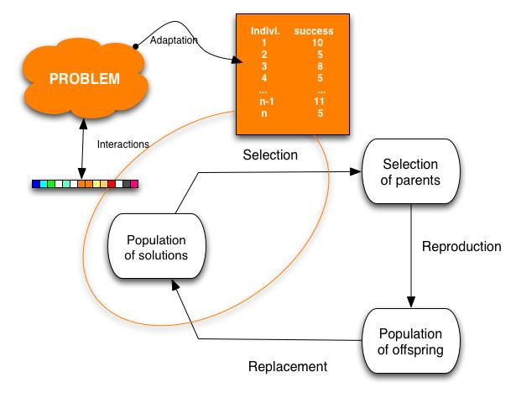
Genetic algorithms
Variant of local beam search with sexual recombination.

Slide 74
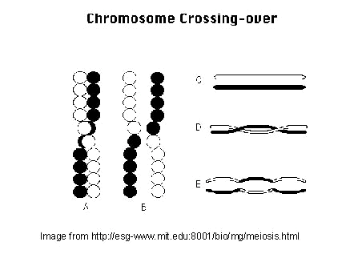
Recombination (crossover)

Slide 75


Genetic algorithms
Variant of local beam search with sexual recombination.

Slide 76
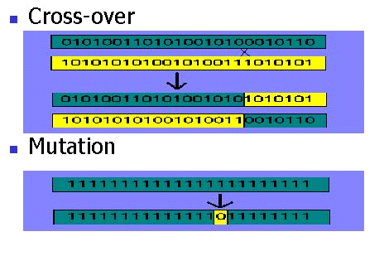
Genetic operators

Slide 77
Genetic algorithm
function GENETIC_ALGORITHM( population, FITNESS-FN) return an individual
input: population, a set of individuals
FITNESS-FN, a function which determines the quality of the individual
repeat
new_population ← empty set
loop for i from 1 to SIZE(population) do
x ← RANDOM_SELECTION(population, FITNESS_FN) y ← RANDOM_SELECTION(population, FITNESS_FN)
child ← REPRODUCE(x,y)
if (small random probability) then child ← MUTATE(child )
add child to new_population
population ← new_population
until some individual is fit enough or enough time has elapsed
return the best individual

Slide 78
Exploration problems
Until now all algorithms were offline.
  Offline= solution is determined before executing it.
  Online = interleaving computation and action
Online search is necessary for dynamic and semi-dynamic environments
  It is impossible to take into account all possible contingencies.
Used for exploration problems:
  Unknown states and actions.
  e.g. any robot in a new environment, a newborn baby,…

Slide 79
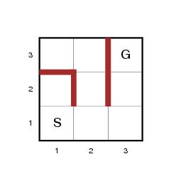
Online search problems
Agent knowledge:
  ACTION(s): list of allowed actions in state s
  C(s,a,s’): step-cost function (! After s’ is determined)
  GOAL-TEST(s)
An agent can recognize previous states.
Actions are deterministic.
Access to admissible heuristic h(s)
e.g. manhattan distance

Slide 80
Online search problems
Objective: reach goal with minimal cost
  Cost = total cost of traveled path
  Competitive ratio=comparison of cost with cost of the solution path if search space is known.
  Can be infinite in case of the agent
  accidentally reaches dead ends

Slide 81
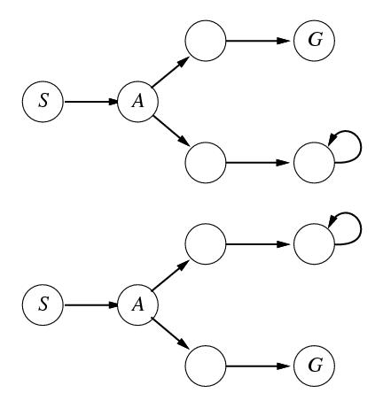
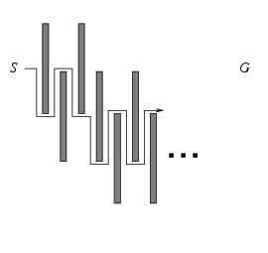
The adversary argument
Assume an adversary who can construct the state space while the agent explores it
  Visited states S and A. What next?
    Fails in one of the state spaces
No algorithm can avoid dead ends in all state spaces.

Slide 82
Online search agents
The agent maintains a map of the environment.
  Updated based on percept input.
  This map is used to decide next action.
State space is safely explorable.
  Note difference with e.g. A*
  An online version can only expand the node it is physically in (local order)

Slide 83
Online DF-search
function ONLINE_DFS-AGENT(s’) return an action
input: s’, a percept identifying current state
static: result, a table indexed by action and state, initially empty
unexplored, a table that lists for each visited state, the action not yet tried
unbacktracked, a table that lists for each visited state, the backtrack not yet
tried
s,a, the previous state and action, initially null
if GOAL-TEST(s’) then return stop
if s’ is a new state then unexplored[s’] ← ACTIONS(s’)
if s is not null then do
result[a,s] ← s’
add s to the front of unbackedtracked[s’]
if unexplored[s’] is empty then
if unbacktracked[s’] is empty then return stop
else a ← an action b such that result[b, s’]=POP(unbacktracked[s’])
else a ← POP(unexplored[s’])
s ← s’
return a

Slide 84
Online DF-search, example
Assume maze problem on 3 x 3 grid.
s’ = (1,1) is initial state
Result, unexplored (UX), unbacktracked (UB), … are empty
s, a are also empty

Slide 85
Online DF-search, example
GOAL-TEST((1,1))?
  s’ != G thus false
(1,1) a new state?
  True
  ACTION((1,1)) -> UX[(1,1)]
    {RIGHT,UP}
s is null?
  True (initially)
UX[(1,1)] empty?
  False
POP(UX[(1,1)])->a
  a=UP
s = (1,1)
Return a
S’=(1,1)

Slide 86
Online DF-search, example
GOAL-TEST((2,1))?
  s’ != G thus false
(2,1) a new state?
  True
  ACTION((2,1)) -> UX[(2,1)]
    {DOWN}
s is null?
  false (s=(1,1))
  result[UP,(1,1)] <- (2,1)
  UB[(2,1)]={(1,1)}
UX[(2,1)] empty?
  False
a=DOWN, s=(2,1) return a
S’=(2,1)
S

Slide 87
Online DF-search, example
GOAL-TEST((1,1))?
  s’ != G thus false
(1,1) a new state?
  false
s is null?
  false (s=(2,1))
  result[DOWN,(2,1)] <- (1,1)
  UB[(1,1)]={(2,1)}
UX[(1,1)] empty?
  False
a=RIGHT, s=(1,1), return a
S’=(1,1)

Slide 88
Online DF-search, example
GOAL-TEST((1,2))?
  s’ != G thus false
(1,2) a new state?
  True, UX[(1,2)]={RIGHT,UP,LEFT}
s is null?
  false (s=(1,1))
  result[RIGHT,(1,1)] <- (1,2)
  UB[(1,2)]={(1,1)}
UX[(1,2)] empty?
  False
a=LEFT, s=(1,2), return a
S’=(1,2)
S

Slide 89
Online DF-search, example
GOAL-TEST((1,1))?
  s’ != G thus false
(1,1) a new state?
  false
s is null?
  false (s=(1,2))
  result[LEFT,(1,2)] <- (1,1)
  UB[(1,1)]={(1,2),(2,1)}
UX[(1,1)] empty?
  True
  UB[(1,1)] empty? False
a= B for B in result[B,(1,1)]=(1,2)
  B=RIGHT
a=RIGHT, s=(1,1) …
S’=(1,1)

Slide 90
Online DF-search
Worst case each node is visited twice.
An agent can go on a long walk even when it is close to the solution.
An online iterative deepening approach solves this problem.
Online DF-search works only when actions are reversible.

Slide 91
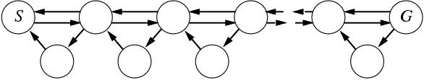
Online local search
Hill-climbing is already online
  One state is stored.
Bad performance due to local maxima
  Random restarts impossible.
Solution: Random walk introduces exploration (can produce exponentially many steps)

